Slide 1
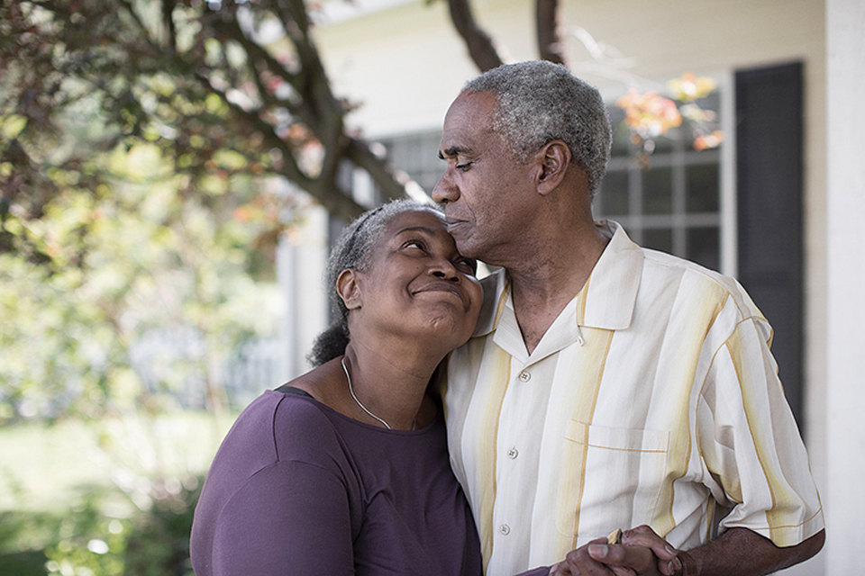
Hamilton County
Caregivers Initiative
TLRC 6.6.2022
December 1, 2021 Board Meeting
June 6, 2022

Slide 2
Initiative Goals
Deliver comprehensive, informative and enjoyable program to Black Hamilton County caregivers that educate, support and empower.
Identify and address individual barriers to participation.
Provide information and resources participants feel safe using.
Comprehensive understanding of caregivers in Hamilton County.
Assist in creating community among cohorts to facilitate extended support system.
Evaluation
Personal Assessment interview
Pre/Post Survey with Caregiver Reaction Scale

Slide 3
Intervention Outline
Support & Resources– respite, support organization, what insurance pays for, adult daycare, social services, benefits, why important, record keeping Communication with cared-for, with doctors, family, relationships, etc. Scenario planning/role play. Family Care consultation / Safety / Medication Management Self-Care & Caregiver Burnout Type of caregiver by disease state – breakout rooms with experts (define by assessment) What’s Next & Review + Graduation – How to continue, support groups

Slide 4
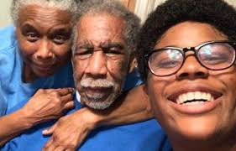
Outreach & Recruit Plan
Meeting caregivers where they are
Virtual Info session
Health Gap Community Events
Dedicated Senior Medical Centers
Community Centers
Doctor Offices
Facebook & other support groups
Community audit of municipality organizations
Marketing & Promotions (Social Media, Radio, Print)
Ongoing Recruitment
Focused Municipalities
Forest Park
Lincoln Heights
Mount Healthy
Springfield Township
Lockland
Arlington Heights
Elmwood Place

Slide 5
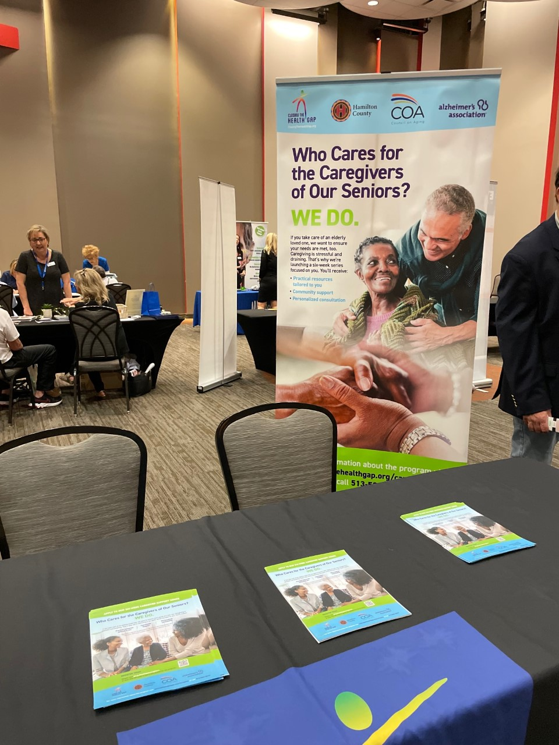

Slide 6
Partnerships
Council on Aging of Southwestern Ohio
Alzheimer’s
Faith-based organizations
Respite Care
Transportation Services
Providing
Knowledge Exchange
Participants materials for adaptation
Session Expert
Resource

Slide 7
Pilot Launching June 7
23 residents registered for pilot
Promotions – outreach, radio, online ads
Retirement Expo May 6
Caring for Caregivers Virtual Townhall May 31
IRB process underway
Next Cohort begins July 19 in Forest Park
Kicking off online module development

Slide 8
Development of Research Tools & Protocol
Quantitative Questionnaire
Qualitative Guide
Participant Needs Assessment
IRB (Institutional Review Board) Start
Qualtrics
Follow-up
Development of Database for Recruiting & Expert Panel
Caregiver screener added to other Health Research
Social media recruit
Interviews with Expert Panelists
Partners’ list
Community audit

Slide 9
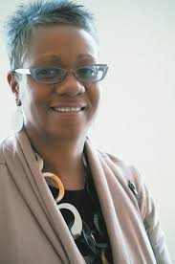
6. Publish results/whites, manuals
Renee Mahaffey Harris, CHES
President/CEO
The Center for Closing the Health Gap
513.585.9875
closingthehealthgap.org
CloseHealthGap/
health_gap/
CCHGcincy

